Slide 1
Cooperating Intelligent Systems
Informed search
Chapter 4, AIMA 2nd ed
Chapter 3, AIMA 3rd ed

Slide 2
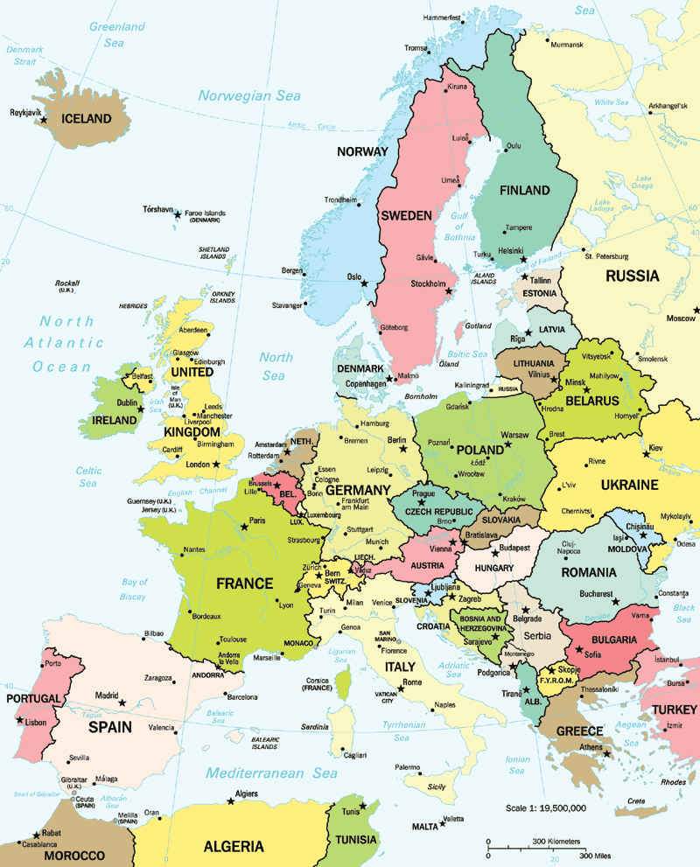

Slide 3

Romania

Slide 4
Romania

Slide 5
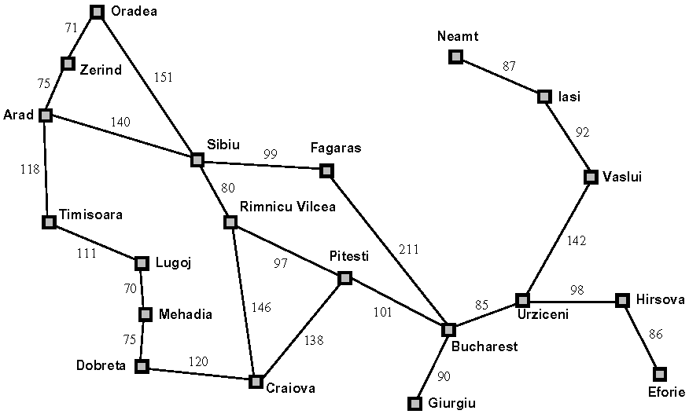

Slide 6
Romania problem
Initial state: Arad
Find the minimum distance path to Bucharest.

Slide 7
Informed search
Searching for the goal and knowing something about in which direction it is.
Evaluation function: f(n)
- Expand the node with minimum f(n)
Heuristic function: h(n)
- Our estimated cost of the path from node n to the goal.

Slide 8
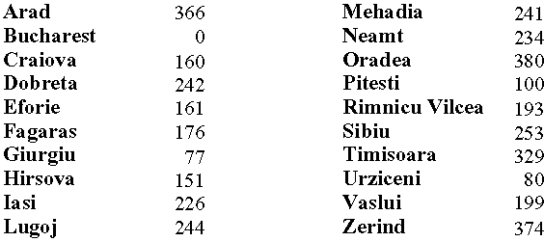
Example heuristic function h(n)
h_{SLD} – Straight-line distances (km) to Bucharest

Slide 9
Greedy best-first (GBFS)
Expand the node that appears to be closest to the goal: f(n) = h(n)
Incomplete (infinite paths, loops)
Not optimal (unless the heuristic function is a correct estimate)
Space and time complexity ~ O(b^{d})

Slide 10
Assignment: Expand the
nodes in the greedy-best-
first order, beginning from
Arad and going to Bucharest
These are the h(n)
values.

Slide 11
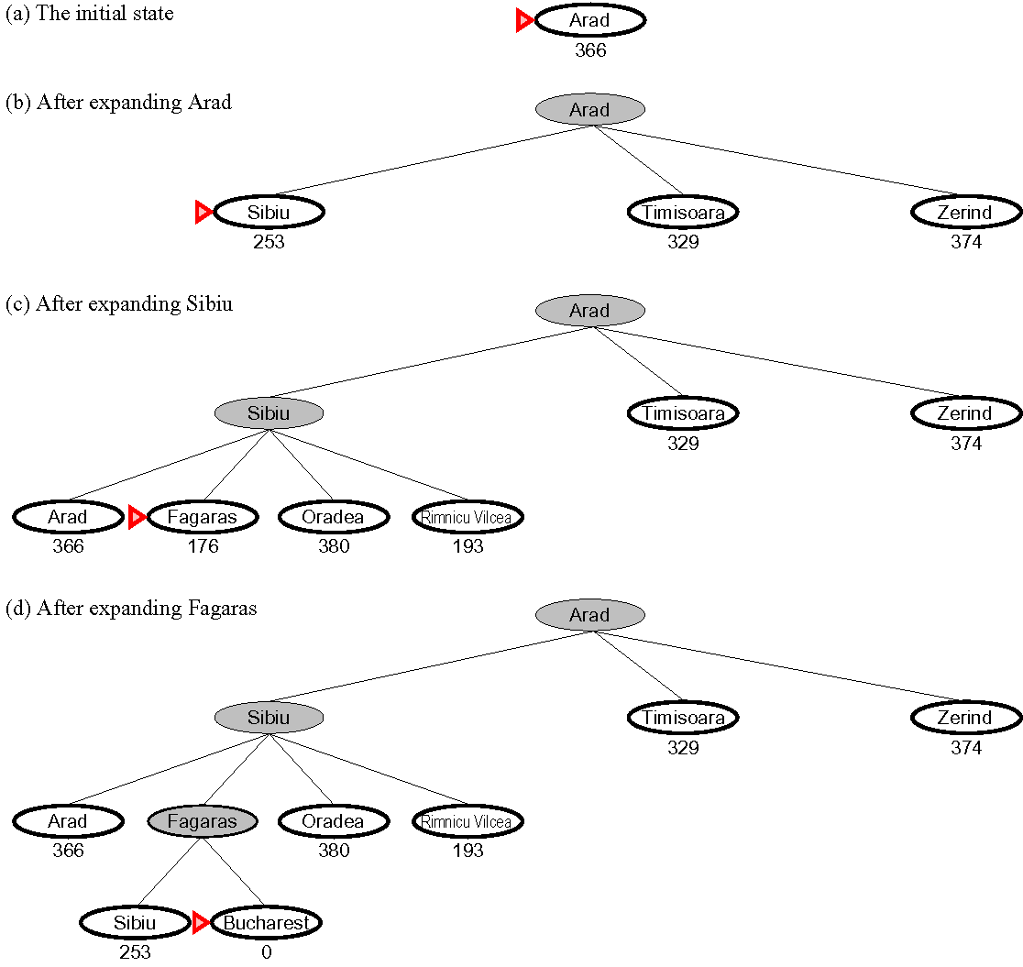
Map
Path cost = 450 km

Slide 12
Romania problem: GBFS
Initial state: Arad
Find the minimum distance path to Bucharest.
374
253
329

Slide 13
Romania problem: GBFS
Initial state: Arad
Find the minimum distance path to Bucharest.
380
366
176
193

Slide 14
Romania problem: GBFS
Initial state: Arad
Find the minimum distance path to Bucharest.
253
0
Not the optimal solution
Path cost = 450 km

Slide 15
A and A* best-first search
A: Improve greedy search by discouraging wandering off: f(n) = g(n) + h(n)
Here g(n) is the cost to get to node n from the start position.
This penalizes taking steps that don’t improve things considerably.
A*: Use an admissible heuristic, i.e. a heuristic h(n) that never overestimates the true cost for reaching the goal from node n.

Slide 16
Assignment: Expand the
nodes in the A* order,
beginning from Arad and
going to Bucharest
These are the g(n)
values.
These are the h(n)
values.

Slide 17
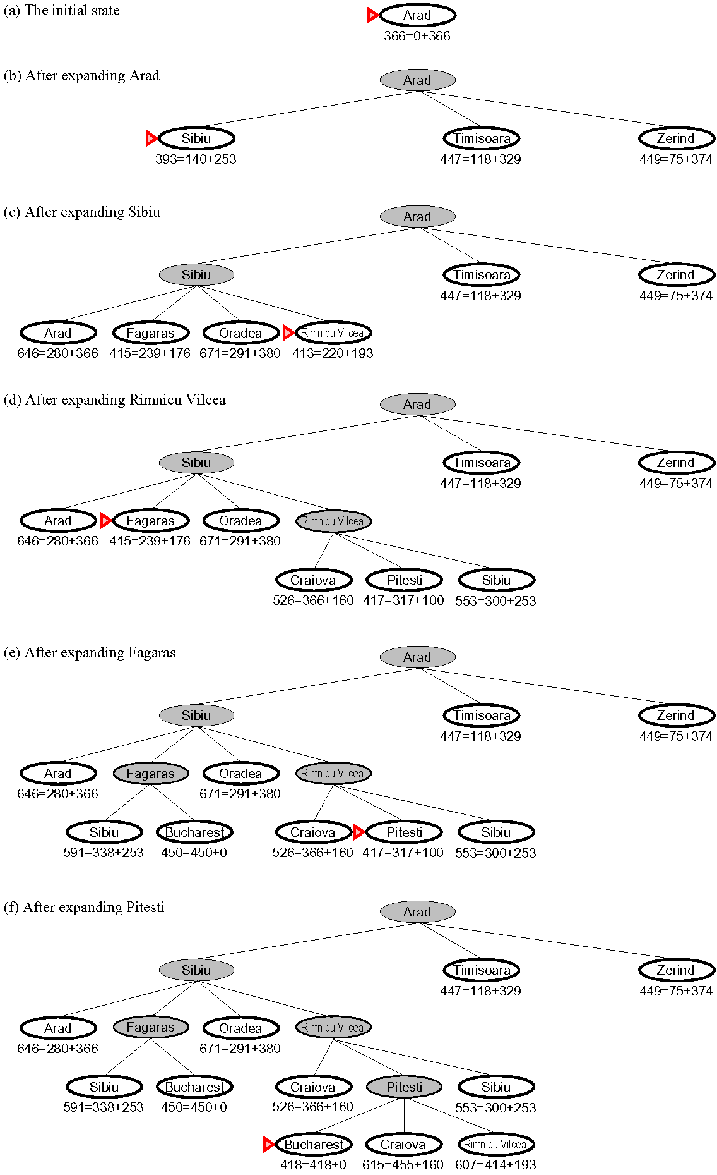
= g(n) + h(n)
The straight-line distance never overestimates the true distance; it is an admissible heuristic.
A* on the Romania problem.
Rimnicu-Vilcea is expanded before Fagaras.
The gain from expanding Fagaras is too small so the A* algorithm backs up and expands Fagaras.
None of the descentants of Fagaras is better than a path through Rimnicu-Vilcea; the algorithm goes back to Rimnicu-Vilcea and selects Pitesti.
The final path cost = 418 km
This is the optimal solution.

Slide 18
= g(n) + h(n)
The straight-line distance never overestimates the true distance; it is an admissible heuristic.
A* on the Romania problem.
Rimnicu-Vilcea is expanded before Fagaras.
The gain from expanding Rimnicu-Vilcea is too small so the A* algorithm backs up and expands Fagaras.
None of the descentants of Fagaras is better than a path through Rimnicu-Vilcea; the algorithm goes back to Rimnicu-Vilcea and selects Pitesti.
The final path cost = 418 km
This is the optimal solution.

Slide 19
= g(n) + h(n)
The straight-line distance never overestimates the true distance; it is an admissible heuristic.
A* on the Romania problem.
Rimnicu-Vilcea is expanded before Fagaras.
The gain from expanding Rimnicu-Vilcea is too small so the A* algorithm backs up and expands Fagaras.
None of the descentants of Fagaras is better than a path through Rimnicu-Vilcea; the algorithm goes back to Rimnicu-Vilcea and selects Pitesti.
The final path cost = 418 km
This is the optimal solution.

Slide 20
= g(n) + h(n)
The straight-line distance never overestimates the true distance; it is an admissible heuristic.
A* on the Romania problem.
Rimnicu-Vilcea is expanded before Fagaras.
The gain from expanding Rimnicu-Vilcea is too small so the A* algorithm backs up and expands Fagaras.
None of the descentants of Fagaras is better than a path through Rimnicu-Vilcea; the algorithm goes back to Rimnicu-Vilcea and selects Pitesti.
The final path cost = 418 km
This is the optimal solution.

Slide 21
Romania problem: A*
Initial state: Arad
Find the minimum distance path to Bucharest.
The optimal solution
Path cost = 418 km

Slide 22
Theorem: A* tree-search is optimal
A and B are two nodes on the fringe.
A is a suboptimal goal node and B is a node on the optimal path.
Optimal path cost = C
Optimal path
B
A

Slide 23
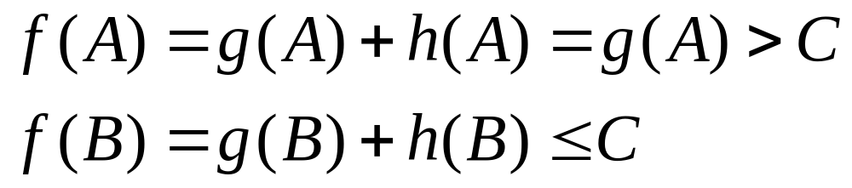
Theorem: A* tree-search is optimal
A and B are two nodes on the fringe.
A is a suboptimal goal node and B is a node on the optimal path.
Optimal path cost = C
Optimal path
B
A
h(A) = 0
h(n) is admissive heuristic

Slide 24
Theorem: A* tree-search is optimal
A and B are two nodes on the fringe.
A is a suboptimal goal node and B is a node on the optimal path.
Optimal path cost = C
Optimal path
B
A
⇒ No suboptimal goal node will be selected before the optimal goal node

Slide 25
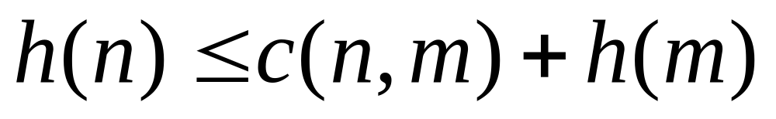
Is A* graph-search optimal?
Previous proof works only for tree-search
For graph-search we add the requirement of consistency (monotonicity):
c(n,m) = step cost for going from node n to node m (n comes before m)
m
h(m)
c(n,m)
n
h(n)
goal

Slide 26
A* graph search with consistent heuristic is optimal
Theorem:
If the consistency condition on h(n) is satisfied, then when A* expands a node n, it has already found an optimal path to n.
This follows from the fact that consistency means that f(n) is nondecreasing along a path in the graph
if m comes after n along a path

Slide 27
Proof
A* has reached node m along the alternative path B.
Path A is the optimal path to node m.
⇒ g_{A}(m) ≤ g_{B}(m)
Node n precedes m along the optimal path A.
⇒ f_{A}(n) ≤ f_{A}(m)
Both n and m are on the fringe and A* is about to expand m.
⇒ f_{B}(m) ≤ f_{A}(n)
A
B
n
Optimal path
m

Slide 28
Proof
A* has reached node m along the alternative path B.
Path A is the optimal path to node m.
⇒ g_{A}(m) ≤ g_{B}(m)
Node n precedes m along the optimal path A.
⇒ f_{A}(n) ≤ f_{A}(m)
Both n and m are on the fringe and A* is about to expand m.
⇒ f_{B}(m) ≤ f_{A}(n)
A
B
n
Optimal path
m

Slide 29
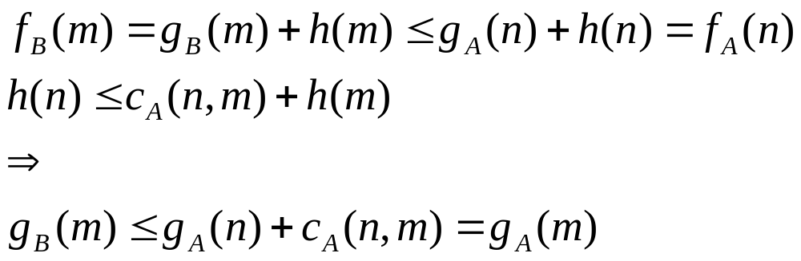
Proof
A
B
n
But path A is optimal to reach m why g_{A}(m) ≤ g_{B}(m)
Thus, either m = n or contradiction.
Optimal path
m
⇒ A* graph-search with consistent heuristic always finds the optimal path

Slide 30
A*
Optimal
Complete
Optimally efficient (no algorithm will expand fewer nodes, given the same heuristic)
Memory requirement exponential...(bad)
Time complexity exponential (worst case, depends on heuristic)

Slide 31
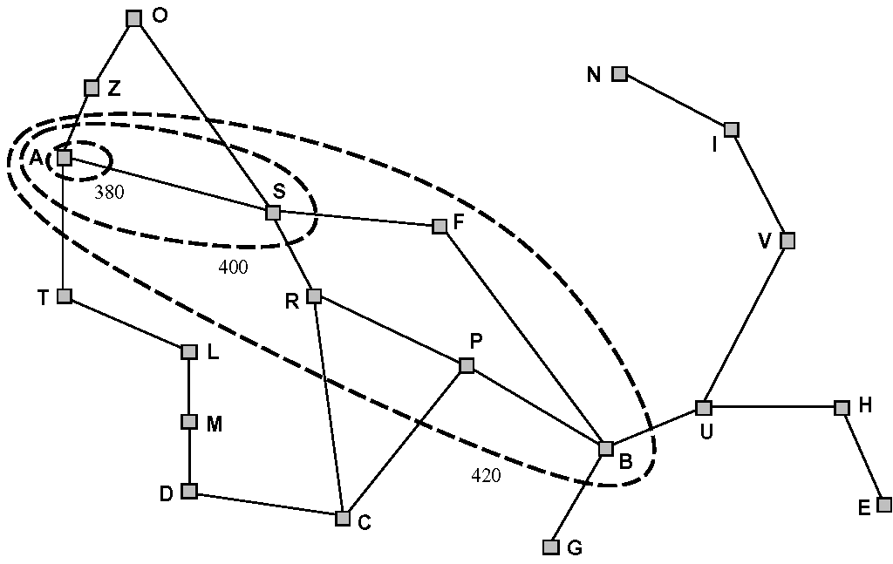
Romania problem: A*
Initial state: Arad
Find the minimum distance path to Bucharest.
The optimal solution
Path cost = 418 km

Slide 32
Romania problem: A*
Initial state: Arad
Find the minimum distance path to Bucharest.
Never expanded nodes
A* expands all nodes with f-value less than
the optimal cost to the goal.
The optimal solution
Path cost = 418 km

Slide 33
Memory bounded search
Iterative deepening A* (IDA*) (uses f cost)
Recursive best-first search (RBFS)
  Depth-first but keep track of best f-value so far above.
Memory-bounded A* (MA*/SMA*)
  Drop old/bad nodes when memory gets full (but parent remembers worst deleted child).
Best of these is SMA*

Slide 34
Heuristic functions 8-puzzle
Can you come up with heuristics for the 8-puzzle?
Think about it for a while and come with suggestions.
2
8
3
1
6
4
7
5
h₁ = 5, h₂ = 5
1
2
3
8
4
7
6
5
Goal state

Slide 35
Heuristic functions 8-puzzle
h₁ = The number of misplaced tiles.
h₂ = The sum of the distances of the tiles from their respective goal positions (Manhattan distance).
Both are admissive
2
8
3
1
6
4
7
5
h₁ = 5, h₂ = 5
1
2
3
8
4
7
6
5
Goal state

Slide 36
Heuristic functions 8-puzzle
Initial state
h₁ = The number of misplaced tiles.
Assignment: Expand the first three levels of the search tree using A* and the heuristic h₁.
2
8
3
1
6
4
7
5
h₁ = 5, h₂ = 5
1
2
3
8
4
7
6
5
Goal state

Slide 37
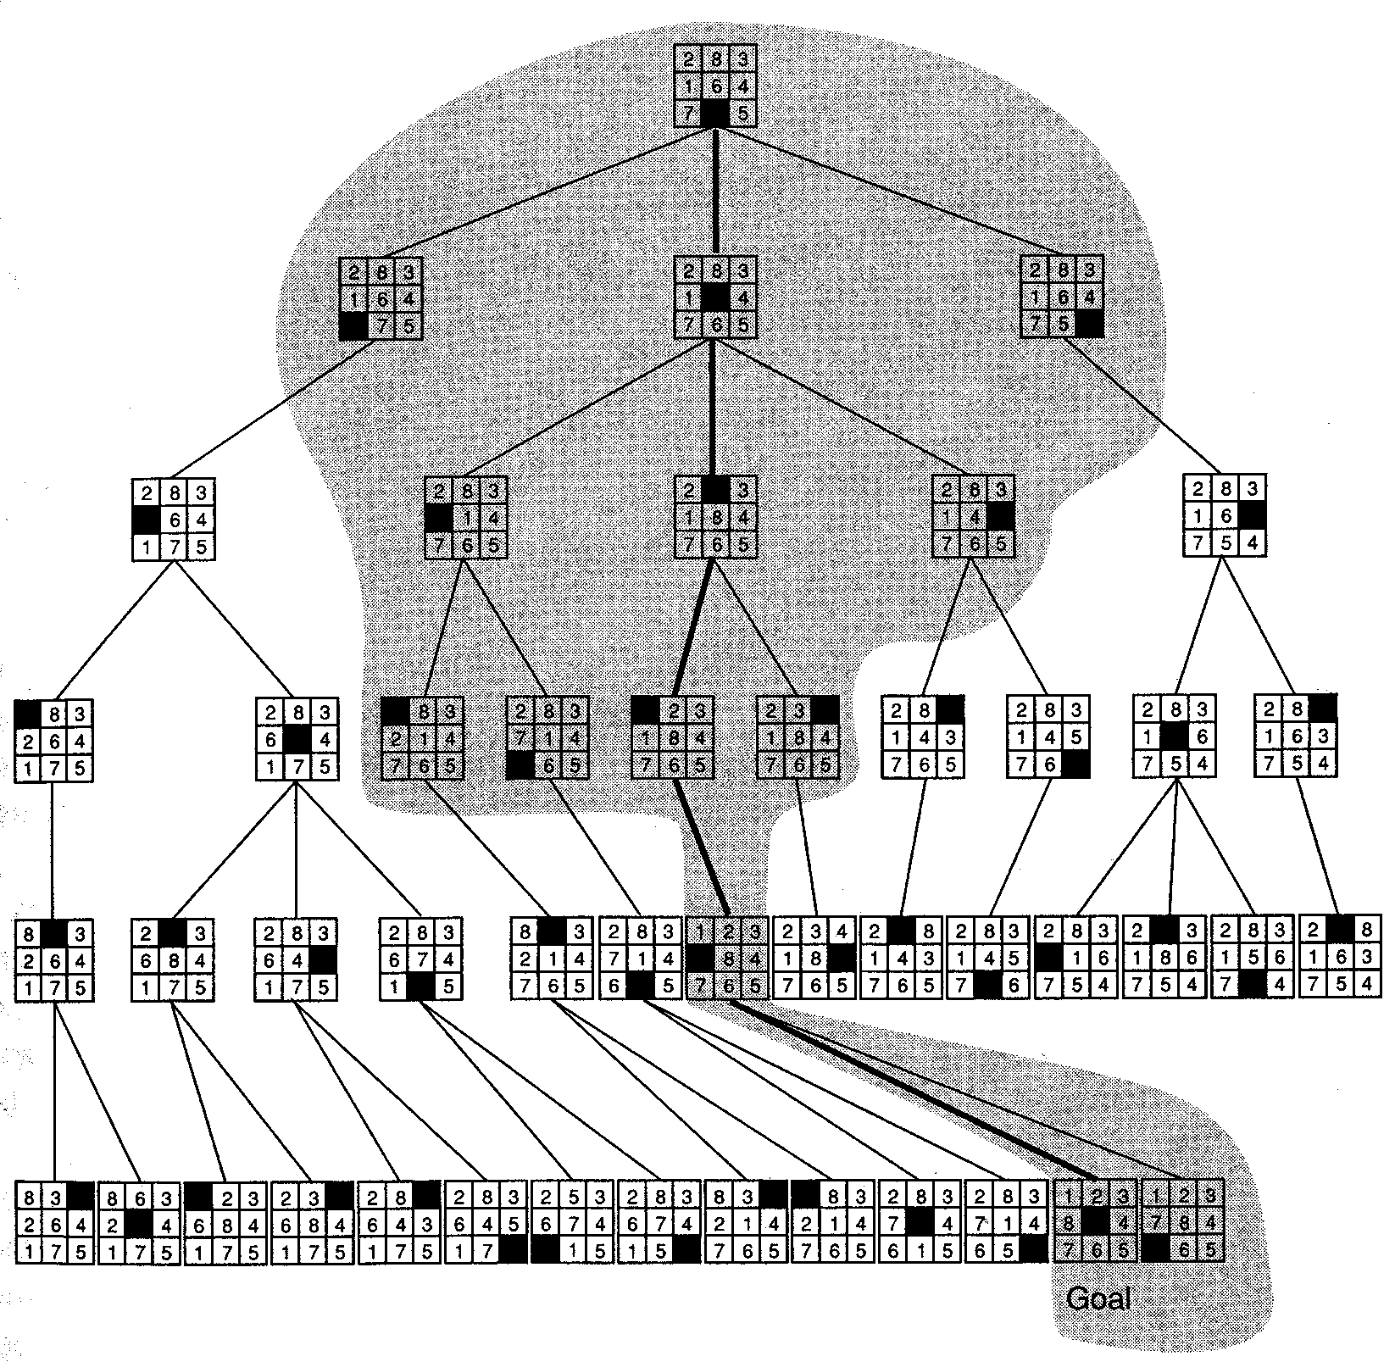
A* on 8-puzzle, h₁ heuristic
Only nodes in shaded
area are expanded
Goal reached
in node #13
Image from G. F. Luger, ”Artificial Intelligence” (4th ed.) 2002

Slide 38
Domination
It is obvious from the definitions that
h₁(n) ≤ h₂(n).
We say that h₂ dominates h₁.
All nodes expanded with h₂ are also expanded with h₁ (but not vice versa). Thus, h₂ is better.

Slide 39
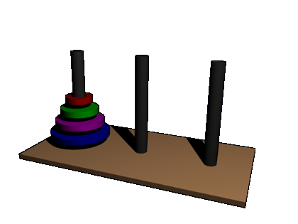
Exercise: Towers of Hanoi
Animation from http://www.eisbox.net/wp-uploads/archive/hanoi.gif
Three rods and N disks with holes in them (so that they can be placed on the rods).
The task is to move all disks from the leftmost rod on to the rightmost rod, without
ever placing a larger disk on top of a smaller disk

Slide 40
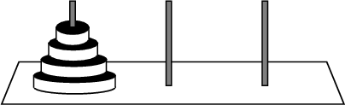
Exercise: Towers of Hanoi
Design a heuristic function for the Towers of Hanoi problem
  Hint: Try to find an exact solution to the relaxed problem
Image borrowed from http://mathworld.wolfram.com/TowersofHanoi.html

Slide 41
Exercise: Towers of Hanoi
Suggestions:
Number of disks on top of the largest disk when the largest disk is not in place

Slide 42
Exercise: Towers of Hanoi
Suggestions:
Number of disks on top of the largest disk when the largest disk is not in place
The number of disks that are not in place

Slide 43
Exercise: Towers of Hanoi
Suggestions:
Number of disks on top of the largest disk when the largest disk is not in place
The number of disks that are not in place
Sum of [2 × (the number of disks that are not in place)-1] over each non-goal peg, and add 2 × (the number of disks not in place) on the goal peg

Slide 44
Exercise: Towers of Hanoi
Suggestions:
Number of disks on top of the largest disk when the largest disk is not in place
The number of disks that are not in place
Sum of [2 × (the number of disks that are not in place)-1] over each non-goal peg, and add 2 × (the number of disks not in place) on the goal peg
Which one is best???

Slide 45
Exercise: Towers of Hanoi
Suggestions:
Number of disks on top of the largest disk when the largest disk is not in place
The number of disks that are not in place
Sum of [2 × (the number of disks that are not in place)-1] over each non-goal peg, and add 2 × (the number of disks not in place) on the goal peg
(1) < (2) < (3)

Slide 46
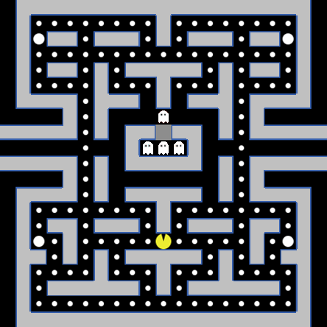
Example: Pac-Man

Slide 47
Example: Pac-Man
Define the state space for the game
What is the maximum branching factor for the game?
For a game with N squares where Pac-Man can be (and that can be occupied by dots), what is the size of the state space?
What is the goal test?
Formulate a suitable heuristic for the game. Explain why it is a suitable heuristic.
Will it make any difference which informed search method you use?

Slide 48
Example: Pac-Man
Define the state space for the game
What is the maximum branching factor for the game?
For a game with N squares where Pac-Man can be (and that can be occupied by dots), what is the size of the state space?
What is the goal test?
Formulate a suitable heuristic for the game. Explain why it is a suitable heuristic.
Will it make any difference which informed search method you use?

Slide 49
Example: Pac-Man
Define the state space for the game
What is the maximum branching factor for the game?
For a game with N squares where Pac-Man can be (and that can be occupied by dots), what is the size of the state space?
What is the goal test?
Formulate a suitable heuristic for the game. Explain why it is a suitable heuristic.
Will it make any difference which informed search method you use?
Each square can be empty, occupied by a dot or by Pac-Man,
i.e. we can have the values {e, d, p} for every square.
The constraint is that there is only one Pac-Man (only one square with
value p). The task is to have all dots eaten (i.e. no square with value d).
The initial state is then described as
{…, d, d, d, d, p, d, d, d, d, …}
The nodes that can be expanded (next states) are:
{…, d, d, d, d, e, p, d, d, d, …}
and
{…, d, d, d, p, e, d, d, d, d, …}

Slide 50
Example: Pac-Man
Define the state space for the game
What is the maximum branching factor for the game?
For a game with N squares where Pac-Man can be (and that can be occupied by dots), what is the size of the state space?
What is the goal test?
Formulate a suitable heuristic for the game. Explain why it is a suitable heuristic.
Will it make any difference which informed search method you use?

Slide 51
Example: Pac-Man
Define the state space for the game
What is the maximum branching factor for the game?
For a game with N squares where Pac-Man can be (and that can be occupied by dots), what is the size of the state space?
What is the goal test?
Formulate a suitable heuristic for the game. Explain why it is a suitable heuristic.
Will it make any difference which informed search method you use?
Pac-Man can move (at most) up, down, left and right.
This means that the maximum branching factor is 4.

Slide 52
Example: Pac-Man
Define the state space for the game
What is the maximum branching factor for the game?
For a game with N squares where Pac-Man can be (and that can be occupied by dots), what is the size of the state space?
What is the goal test?
Formulate a suitable heuristic for the game. Explain why it is a suitable heuristic.
Will it make any difference which informed search method you use?

Slide 53
Example: Pac-Man
Define the state space for the game
What is the maximum branching factor for the game?
For a game with N squares where Pac-Man can be (and that can be occupied by dots), what is the size of the state space?
What is the goal test?
Formulate a suitable heuristic for the game. Explain why it is a suitable heuristic.
Will it make any difference which informed search method you use?
There are three possible states for every square so the size is 3^{N}.
(Actually quite a bit less since there is only one Pac-Man on the board
but we are satisfied with this estimate.)

Slide 54
Example: Pac-Man
Define the state space for the game
What is the maximum branching factor for the game?
For a game with N squares where Pac-Man can be (and that can be occupied by dots), what is the size of the state space?
What is the goal test?
Formulate a suitable heuristic for the game. Explain why it is a suitable heuristic.
Will it make any difference which informed search method you use?

Slide 55
Example: Pac-Man
Define the state space for the game
What is the maximum branching factor for the game?
For a game with N squares where Pac-Man can be (and that can be occupied by dots), what is the size of the state space?
What is the goal test?
Formulate a suitable heuristic for the game. Explain why it is a suitable heuristic.
Will it make any difference which informed search method you use?
That there is no dot left in any square
(i.e. the number of squares with value d is zero).

Slide 56
Example: Pac-Man
Define the state space for the game
What is the maximum branching factor for the game?
For a game with N squares where Pac-Man can be (and that can be occupied by dots), what is the size of the state space?
What is the goal test?
Formulate a suitable heuristic for the game. Explain why it is a suitable heuristic.
Will it make any difference which informed search method you use?

Slide 57
Example: Pac-Man
Define the state space for the game
What is the maximum branching factor for the game?
For a game with N squares where Pac-Man can be (and that can be occupied by dots), what is the size of the state space?
What is the goal test?
Formulate a suitable heuristic for the game. Explain why it is a suitable heuristic.
Will it make any difference which informed search method you use?
The number of squares with value d,
this is a minimum number of moves that
Pac-Man must do to empty all the squares.

Slide 58
Example: Pac-Man
Define the state space for the game
What is the maximum branching factor for the game?
For a game with N squares where Pac-Man can be (and that can be occupied by dots), what is the size of the state space?
What is the goal test?
Formulate a suitable heuristic for the game. Explain why it is a suitable heuristic.
Will it make any difference which informed search method you use?

Slide 59
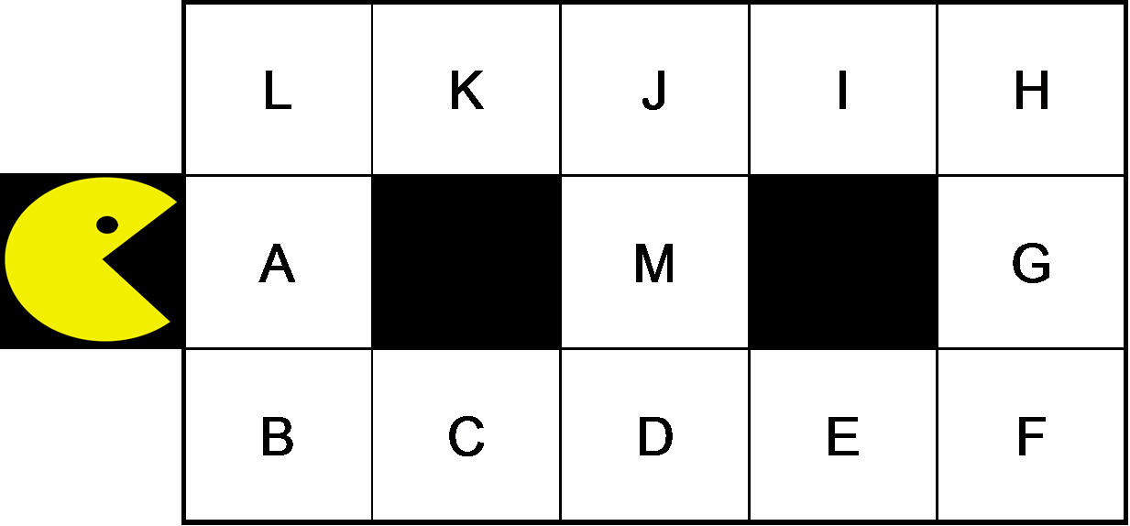
Example: Pac-Man
Define the state space for the game
What is the maximum branching factor for the game?
For a game with N squares where Pac-Man can be (and that can be occupied by dots), what is the size of the state space?
What is the goal test?
Formulate a suitable heuristic for the game. Explain why it is a suitable heuristic.
Will it make any difference which informed search method you use?
Pac-Man is about to eat the dots in the squares A through M, the question is just what the optimal order is (with minimum number of steps).
An optimal order is (e.g.) A-B-C-D-E-F-G-H-I-J-M-J-K-L = 14 moves. A suboptimal order is (e.g.) A-B-C-D-E-F-G-H-I-J-K-L-K-J-M = 15 moves.
The suboptimality of the latter order is not discovered until the 14th move.
A* is better than GBFS (we know this from theory) but there may be no difference between their performance.

Slide 60
Local search
Chapter 4 in AIMA 3rd ed

Slide 61
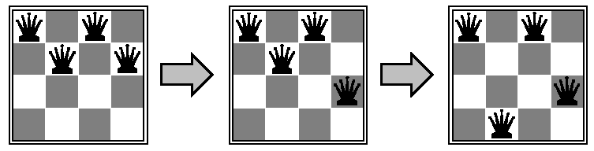
Example: N-queens
From initial state (in N × N chessboard), try to move to other configurations such that the number of conflicts is reduced.

Slide 62
Hill-climbing
Current node = n_{i}.
Grab a neighbor node n_{i+1} and move there if it improves things, i.e.
if Δf = f(n_{i}) - f(n_{i+1}) > 0

Slide 63
Local beam search
Start with k random states
Expand all k states and test their children states.
Keep the k best children states
Repeat until goal state is found

Slide 64
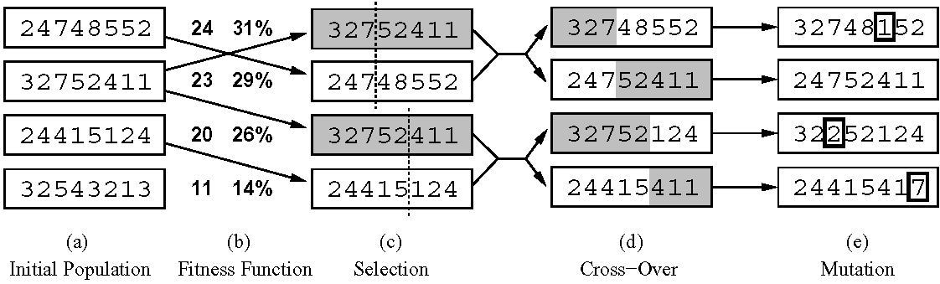
Genetic algorithms
Start with k random states
Selective breeding by mating the best states (with mutation)

